Slide 1
Conformal Predictions
AIML Tech Talk
14 Nov 2023

Slide 2
Content
Uncertainty – Introduction
Types of uncertainty – ML
How to model uncertainty?
Conformal Predictions
Algorithmic Learning in a Random World [Link]
Classification with Valid and Adaptive Coverage [Link]
Conformalized quantile regression - [Link]
Ref:
[1]: Aleatoric and Epistemic Uncertainty in Machine Learning: An Introduction to Concepts and Methods [Link]
[2]: A review of uncertainty quantification in deep learning: Techniques, applications and challenges [Link]
[3]: A Gentle Introduction to Conformal Prediction and Distribution-Free Uncertainty Quantification [Link]

Slide 3
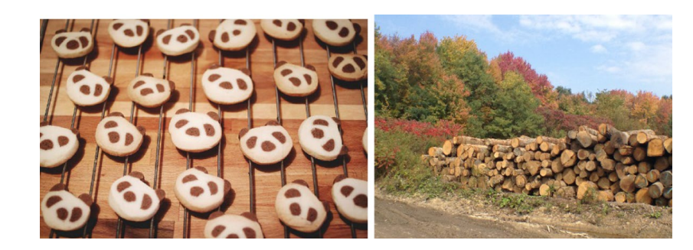
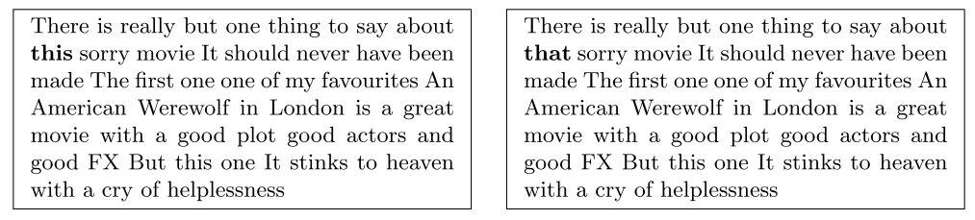
Introduction
Why necessary?
Reliability
Trustworthiness
Why difficult?
Data
Is the data sufficient?
Model
Is the candidate model suitable
Computation cost
How can this be useful?
Estimation of confidence in prediction
Helps with decision making
Predictions from Efficient net.
Left: NN predicts – ‘Typewriter keyboard’ w/ 83.14% certainty.
Right: NN predicts – ‘Stone wall’ w/ 87.63% certainty.
Correct observation
Adversarial example
negative sentiment
positive sentiment
Notes:
We have seen how limited awareness of neural networks of their own competence can lead to incorrect predictions with high confidence
has been demonstrated quite nicely. In the example shown here
For example, experiments on image classifcation have shown that a trained model does often fail on specifc instances, despite being very confdent in its prediction (cf. Fig. 1).
Moreover, such models are often lack robustness and can easily be fooled by “adversarial examples”
Drastic changes of a prediction may already be provoked by minor, or actually unimportant changes of an object.
This problem has not only been observed for images but also for other types of data, such as natural language text
Why is quantifying uncertainty difficult?
Many sources – difficult to idsentify source
Many dl models are treated as black box – lack of theoretical understanding o ftheir work
Absence of causal models – ML models often learn correlations rather than causation
Sensitive to imperfect data
Many approaches require a new model from scratch with lots of alteration
Some approaches can requires 100s of pass through the model to quantify uncertainty
So if we do get an uncertainty estimate, how can this be useful
It can tell us confidence associated with model prediction
Which can be used as a metric of performance
Also can be used in decision making
I will talk about a possible application in pricing

Slide 4
How to quantify Uncertainty
Aleatoric (Statistical) uncertainty
Notion of randomness
Data generation process has stochastic component that is impossible to reduce.
Usually irreducible
Epistemic (systematic) uncertainty
Due to lack of knowledge (of best model)
Ignorance (epistemic state) of designer/agent while designing a ML model
Possibly reducible
How to identify them?
At times difficult to identify
Sometimes we don’t care – if aim is quality of prediction, source is irrelevant
Purely probabilistic approach combines and doesn’t distinguish

Slide 5
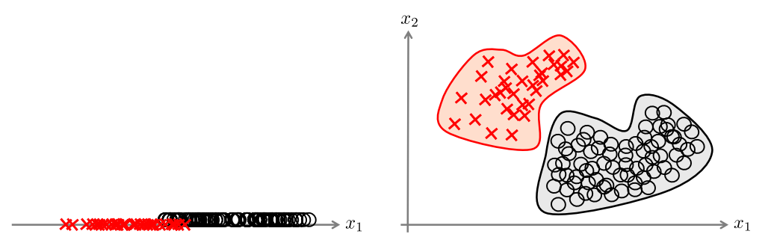
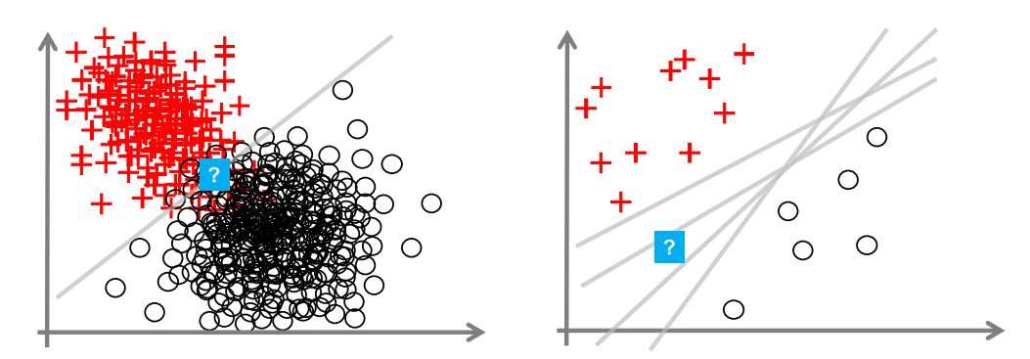
Example
Aleatoric uncertainty
Epistemic uncertainty
Notes:
Here iare few example to understand the difference the two sources uncertainties
In first example, if we use a single feature for learning, the two classes are overlapping, which causes (aleatoric) uncertainty in a certain region of the instance space.
Right: By adding a second feature, and hence embedding the data in a higher-dimensional space, the two classes become separable, and the uncertainty can be resolved
So bascically we had some missing features for the data
For example on epistemic uncertainty
Left: Even with precise knowledge about the optimal hypothesis,
the prediction at the query point (indicated by a question mark) is aleatorically uncertain,
because the two classes are overlapping in that region.
Right: A case of epistemic uncertainty due to a lack of knowledge about the right hypothesis,
which is in turn caused by a lack of data
Now this can be resolved by changing the model – like SVM – choose a model with biggest margin
Or add more (useful) data for training – then this becomes and example of resolving aleatoric uncertainty

Slide 6
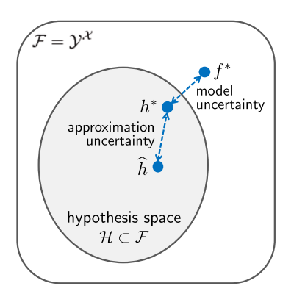
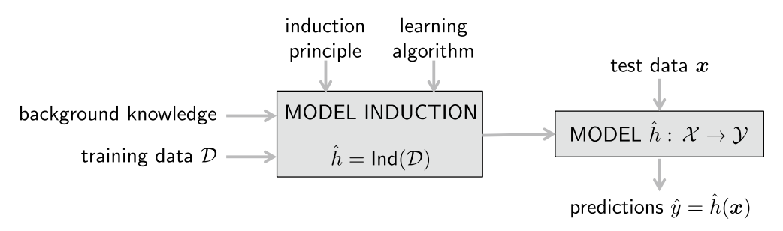

Sources of uncertainty
Aleatoric Uncertainty: The relationship $y=h(x)$ is non-deterministic.
Uncertainty of actual outcome remains uncertain
Model uncertainty: Choice of model family (Hypothesis)
Linear model for a NL relationship
Approximation Uncertainty:
How well the model approximates the true relationship
Notes:
prediction ŷq constitutes the end of a process that consists of diferent learning and approximation steps, all errors and uncertainties related to these steps may also contribute to the uncertainty

Slide 7
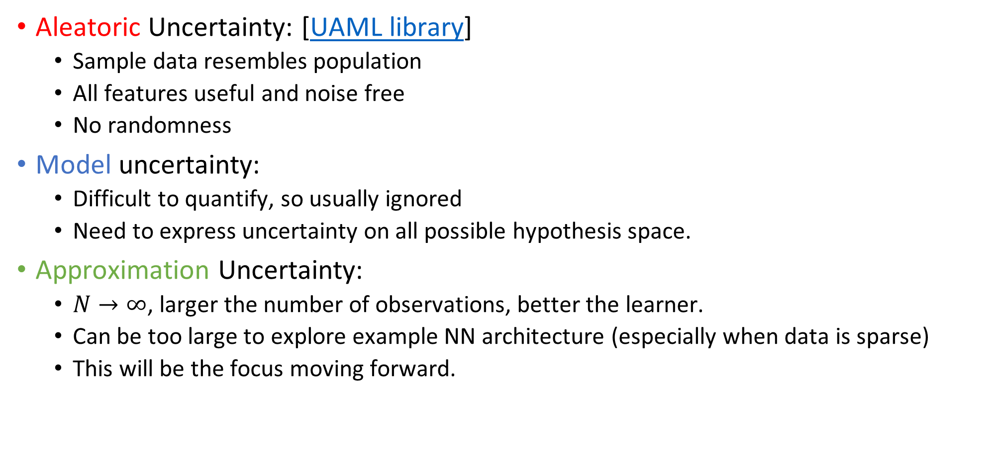
Hypothetical (Ideal world) solutions
Aleatoric Uncertainty: [UAML library]
Sample data resembles population
All features useful and noise free
No randomness
Model uncertainty:
Difficult to quantify, so usually ignored
Need to express uncertainty on all possible hypothesis space.
Approximation Uncertainty:
$N→∞$, larger the number of observations, better the learner.
Can be too large to explore example NN architecture (especially when data is sparse)
This will be the focus moving forward.

Slide 8
How to quantify (approximation) uncertainty?
Modeling Approx. uncertainty
Set based modeling /
Conformal Prediction
Bayesian Inference /
Probability distribution based
Notes:
elaborates on modeling epistemic uncertainty. More specifcally, it considers setbased modeling and modeling with (probability) distributions as two principled approaches to capturing the learner’s epistemic uncertainty about its main target, that is, the (Bayes) optimal model within the hypothesis space

Slide 9
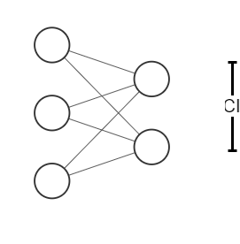
Conformal Prediction
Distribution free Uncertainty quantification
Generate Confidence Intervals (CI)
Using finite samples
For any model
Using any data
w/ (almost) no computation cost
These sets (CI) are valid in a distribution-free sense:
they possess explicit,
non-asymptotic guarantees
even without distributional assumptions or model assumptions

Slide 10
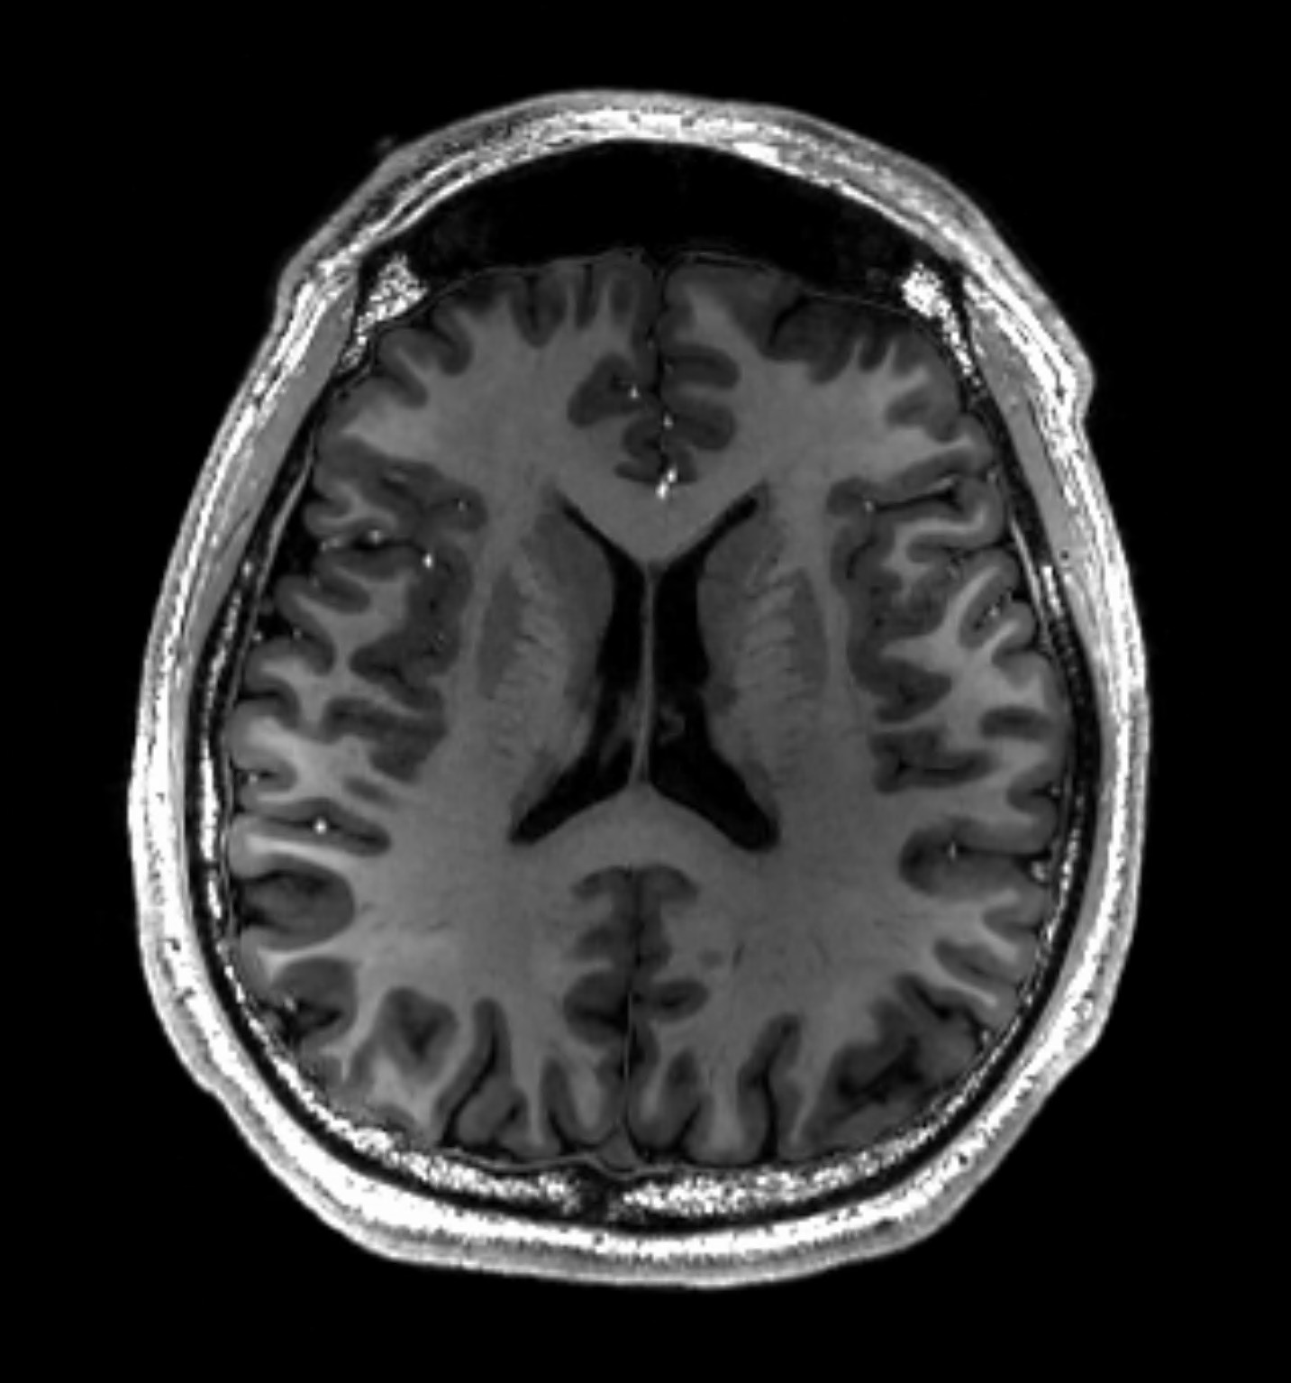

Significance
An MRI image:
Point prediction:
$$argmax \hat{y}=normal$$
Prediction set:
$$\hat{y}∈\left\{normal, cancer\right\}≥90\%$$
Notes:
90% confident the set contains true diagnosis

Slide 11
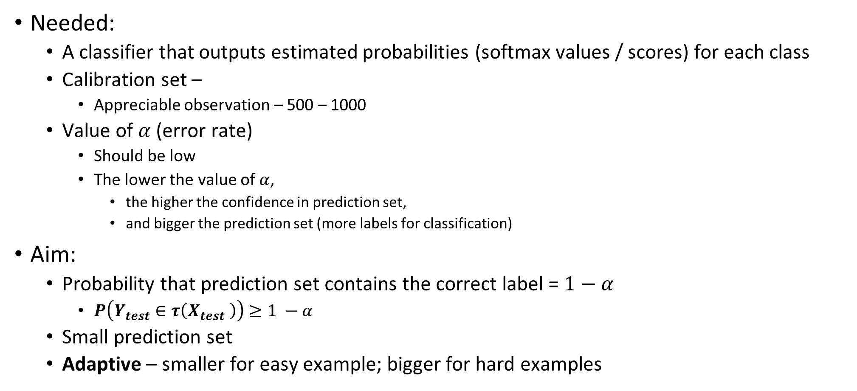
Theory
Needed:
A classifier that outputs estimated probabilities (softmax values / scores) for each class
Calibration set –
Appreciable observation – 500 – 1000
Value of $α$ (error rate)
Should be low
The lower the value of $α$,
the higher the confidence in prediction set,
and bigger the prediction set (more labels for classification)
Aim:
Probability that prediction set contains the correct label = $1−α$
$P\left(Y_{test}∈τ\left(X_{test} \right)\right)≥1 −α$
Small prediction set
Adaptive – smaller for easy example; bigger for hard examples
Notes:
Depends on a correction factor which depends on the size of calibration set
we call this property marginal coverage, since the probability is marginal (averaged) over the randomness in the calibration and test points.
Not close to training data

Slide 12
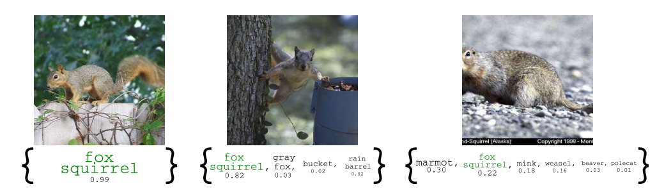
Example
Notes:
Easy to hardest
Easy – full body, background also fine
Head is cutoff, background also not useful
Possibler labels for that example
95% prediction set

Slide 13
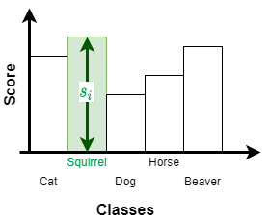
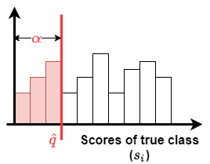
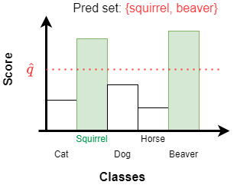
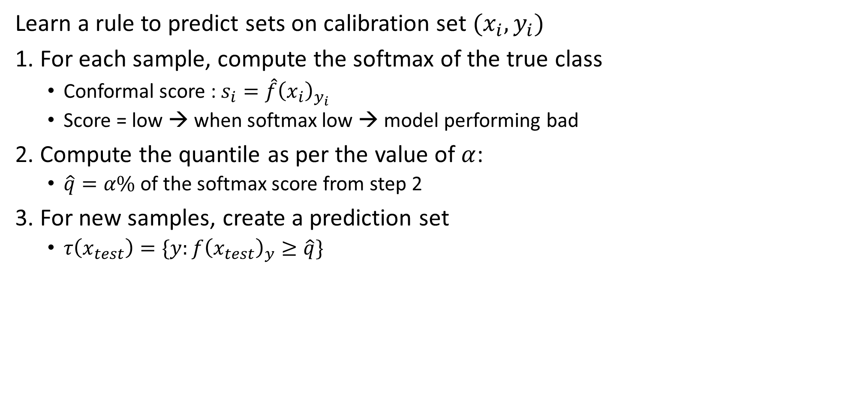

Conformal Prediction – Vork et. al
Learn a rule to predict sets on calibration set ${(x}_{i}, y_{i})$
1. For each sample, compute the softmax of the true class
Conformal score : $s_{i}=\hat{f}{\left(x_{i}\right)}_{y_{i}}$
Score = low → when softmax low → model performing bad
2. Compute the quantile as per the value of $α$:
$\hat{q}=α\%$ of the softmax score from step 2
3. For new samples, create a prediction set
$τ\left(x_{test}\right)=\{y:f{\left(x_{test}\right)}_{y}≥\hat{q}\}$
$$P\left(Y_{test}∈τ\left(X_{test} \right)\right)≥1 −α$$
Notes:
intuitive explanation okay so q hat is this number and what is q hat in english q hat is the number such that at least 90 percent of our examples from our calibration data set have their true classes score above q
and then we're going to look at all of the soft max scores whose level exceeds q hat okay so this one this one and this one and then we're going to put those in a prediction set okay so that's two five eight and that is going to be a valid prediction set hat all right
We get the probabilistic coverage after doing this

Slide 14
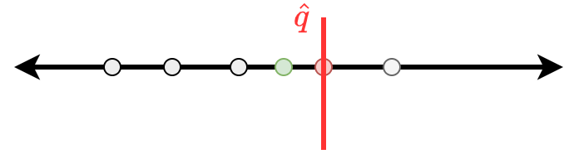
Justification
(1) A Tutorial on Conformal Prediction - YouTube
Notes:
it is coming from this symmetry of the data points
going to hold up for any single model and any true data distribution
i could have seen the data in any particular order okay so
i'm on this number line here i'm plotting the calibration scores in white
so say the calibration scores from data point one and data point two and then in red i'm plotting the score
fresh data point on x n plus 1 y n plus 1. and recall that what we did is we took a particular quantile of those calibration data points and let's say it was this one right here so q hat here is one of my calibration points let's say it fell right here now based on my definition of the set i took all of the y's that made the score less than q hat okay so that what that means is for this fresh data point i'm going to get it right as long as i fall to the left of q hat so i'm going to include y n plus 1 in my
prediction set that which means i'm going to correctly cover that future example as long as that score with the true ym plus one falls to the left of q hat okay okay now comes the kind of amazing symmetry property if you think about this if you think about the location of the the white balls and then the red ball the red ball here is equally likely to fall between any two of these white balls or to the left or right of the most extreme ones so put another way this red guy has probability one over n plus one of falling here it has probability one

Slide 15
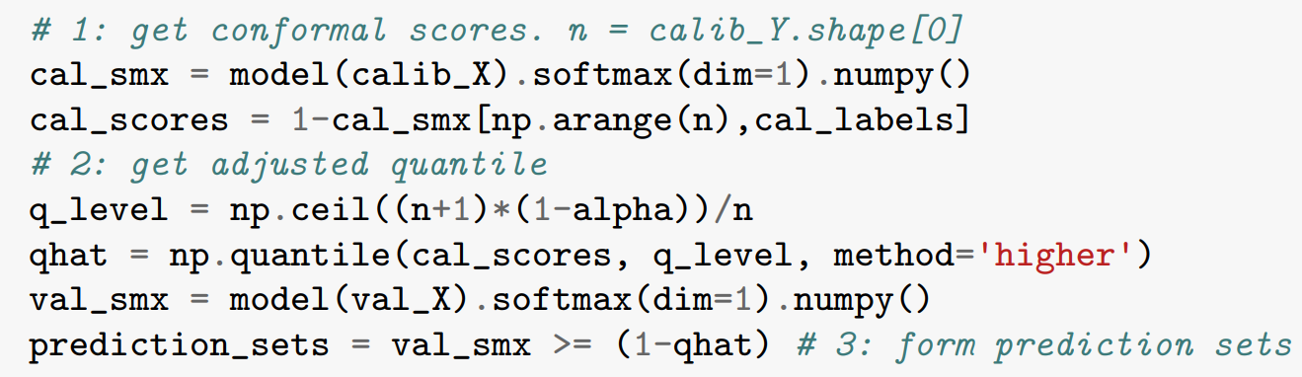
Code walk through
Notebook: Link
Library: MAPIE

Slide 16
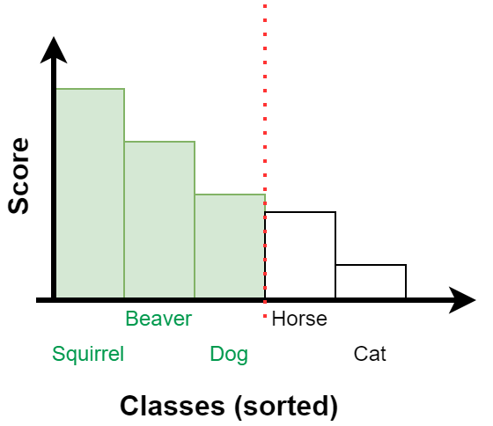
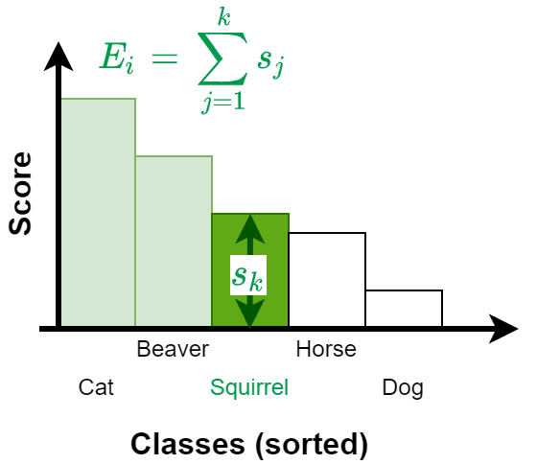
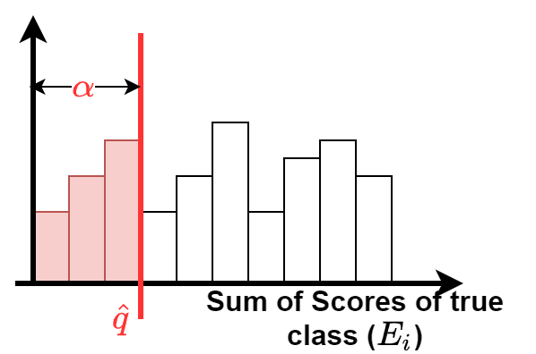
Variations
The above method was good, but it did not provide an adaptive set
Adaptive set property
Another work: Classification with Valid and Adaptive Coverage [Link]
Notes:
Algorithmic Learning in a Random World [Link]

Slide 17
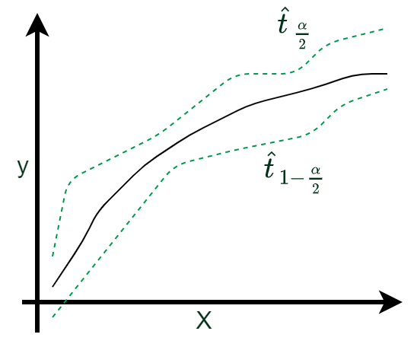
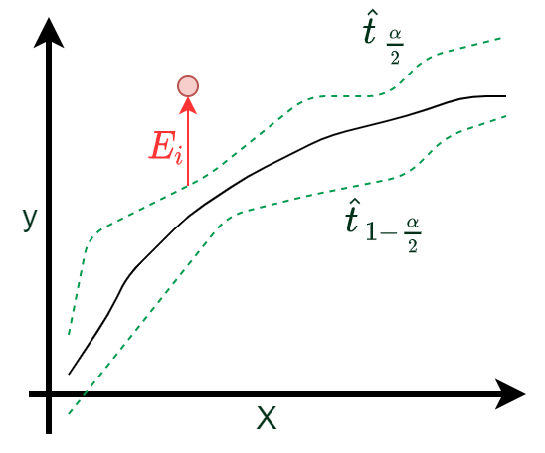
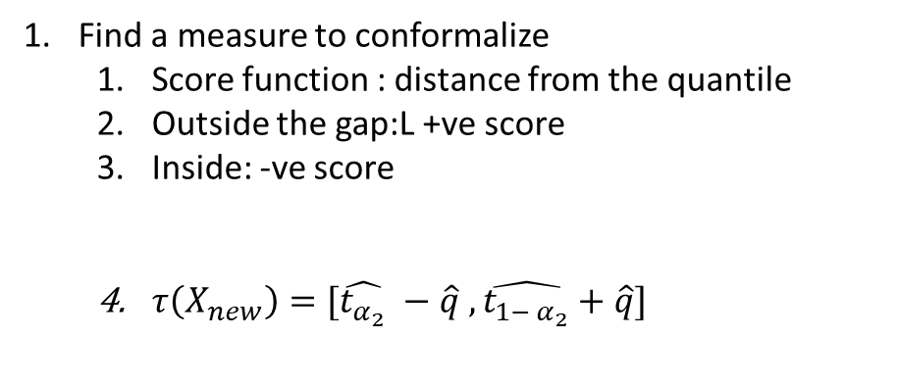
Regression
Find a measure to conformalize
Score function : distance from the quantile
Outside the gap:L +ve score
Inside: -ve score
$τ\left(X_{new}\right)=[\hat{t_{α_{2}}} −\hat{q} ,\hat{t_{{1− α}_{2}}}+\hat{q}]$
Notes:
conformal prediction for regression tests there's a continuous y so in this case y is you know a single for every x there's a single scalar y response
uncertainty aware models which is called quantile regression so what you do is you fit two models you fit a model for the say upper 95 quantile and you fit a model for the lower 90 or the lower 5 percent quantile in this case um these are the two guys say plotted in red in the plot and there's an automatic way of fitting these models um by simply modifying the loss function so you change the loss function from the usual say squared error loss to something slightly different in order to get this lower five percent quantile
it's built into you know pi torch and so on it's called the pinball loss function so you train your neural network with a different loss function to get this upper and lower quantile okay and the promise of these quantiles is that they'll give you approximately the lower five percent and approximately the upper 95 quantile and that's great i know if i had exactly the lower um 5 and the upper 95 quantile i would
i take all i i take any particular observation x n plus one i look at my estimated lower quantile and my estimated upper quantile and i push them apart by that score q hat okay so if ninety percent if the ninety percent largest um gap here were positive so if q hat is a positive number that means that my bands had coverage a little bit less than 90 i wanted that 90 coverage on my calibration data i only saw 85 percent coverage so q hat was a positive number which means i made the bands a little i make the bands a little bit wider

Slide 18
Possible Use cases

